Slide 1

Topics Covered
Representing the board
Functions
While loops
Random module
Tkinter GUI toolkit
Minimax algorithm(AI algorithm)

Slide 2
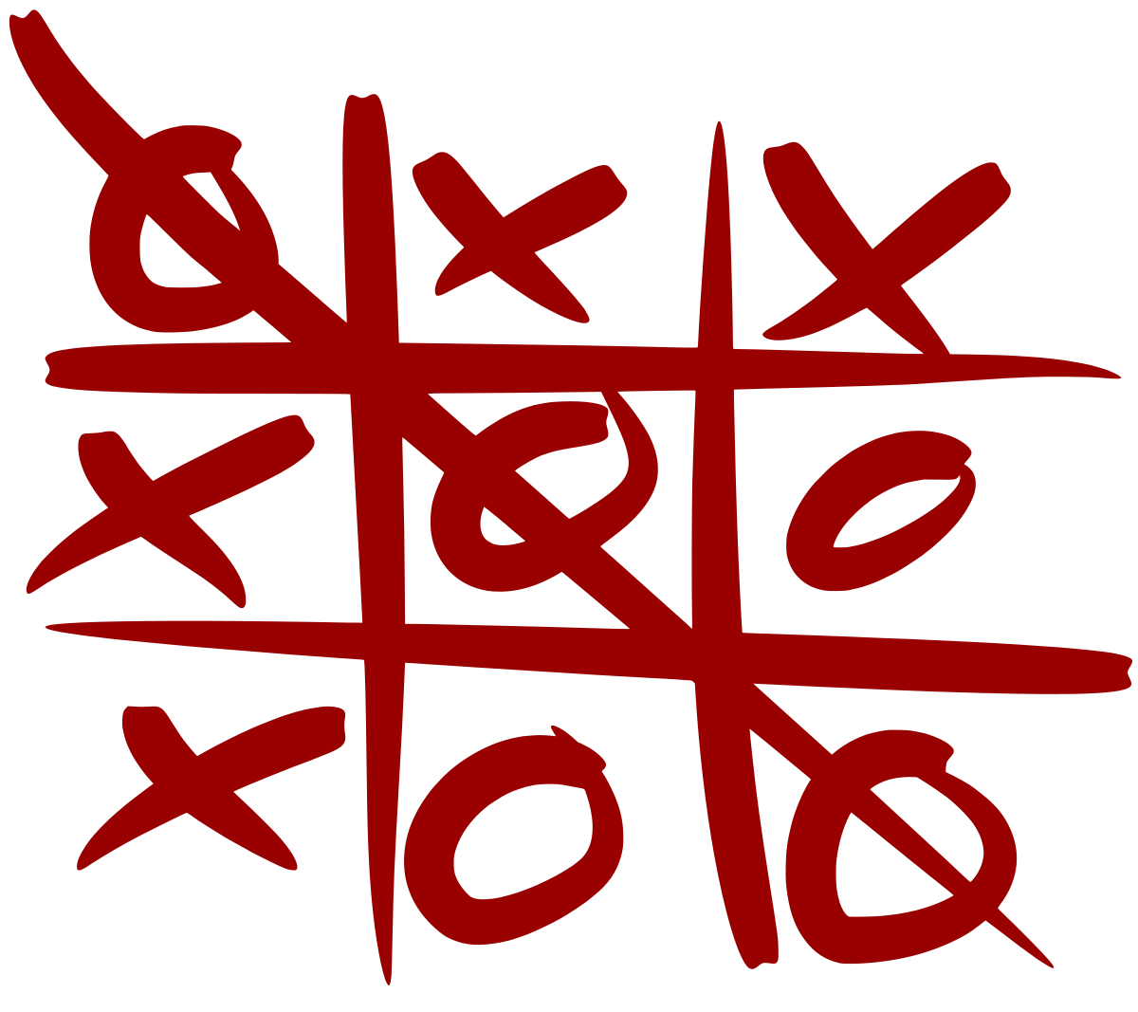
Introduction
Tic tac toe Python, also known as Noughts and Crosses or X’s and O’s, is a very simple two-player game where both the player get to choose any of the symbols between X and O. This game is played on a 3X3 grid board and one by one each player gets a chance to mark its respective symbol on the empty spaces of the grid. Once a player is successful in marking a strike of the same symbol either in the horizontal, vertical or diagonal way as shown in the picture below is created that player wins the game else the game goes on a draw if all the spots are filled.

Slide 3
Methodology
The methodology for building a Tic-Tac-Toe game in Python involves the following steps:
- Set up the game board: Use Tkinter to create the game board, and define a class to represent it.
- Set up the game logic: Define classes for the players and their moves, and create a class to represent the game logic.
- Process player moves: Validate player moves, find a winner, check for ties, and toggle turns.
- Update the game board: Handle player move events, and update the game board to reflect the game state.
- Add a main menu: Provide options to play again or exit the game.
Here are some other things to consider when building a Tic-Tac-Toe game in Python:
- Print the board: Create a function to print the board by creating strings for each row, filling the spaces with values from the board list, and printing each row with separators.
- Determine who goes first: Use a random number generator to choose which player goes first.
- Display gameplay: Iterate over the game array and display elements as crosses or knots depending on their value.
Check for a winner: Check for a winner by looking for three marks in a row, either horizontally, vertically, or diagonally.
- Use the Minimax algorithm: This algorithm minimizes the opponent's payoff while maximizing your own.

Slide 4
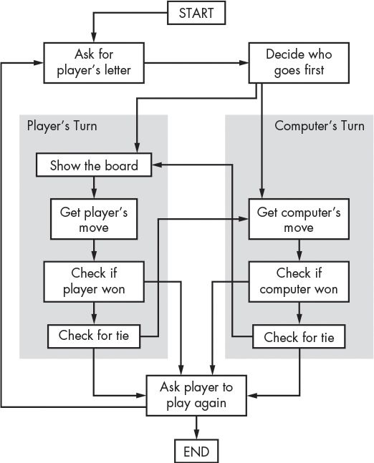
ER Diagram/ DFD

Slide 5
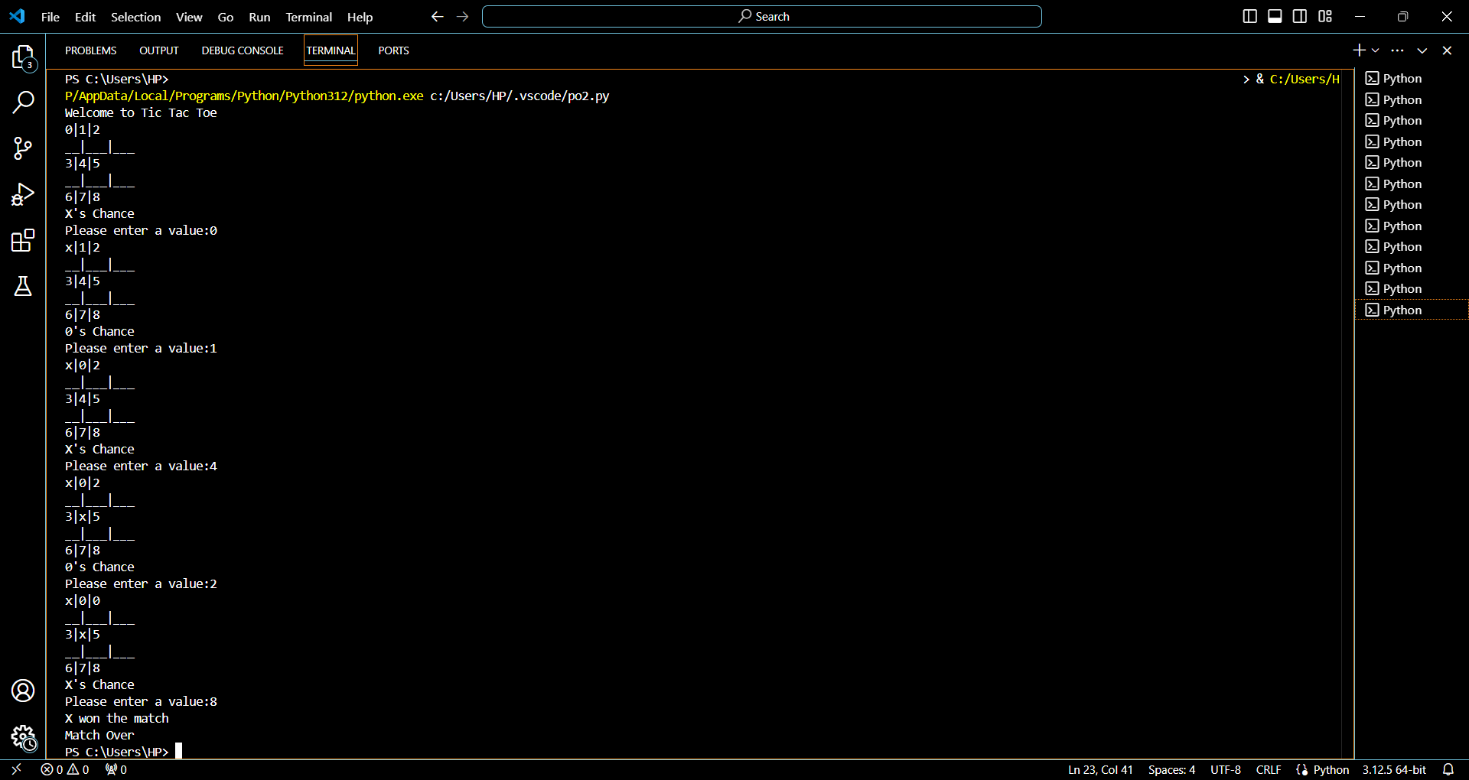
Results / Snapshots

Slide 6
Limitations
No right move: There isn't one right move in tic-tac-toe, as the optimal play is either center or corner.
Maximum number of moves: The maximum number of moves in a game of tic-tac-toe is nine , as the board is filled with either X’s or O’s.

Slide 7
Future Scope
Keyboard functions will be added.
We want to design more complex boards for the game in future.

Slide 8
References
www.google.com/Python project
www.wikipedia.com/Python
Class Notes
www.youtube.com/Python

